Slide 1

PlantKingdom
Decor your home with us…

Slide 2
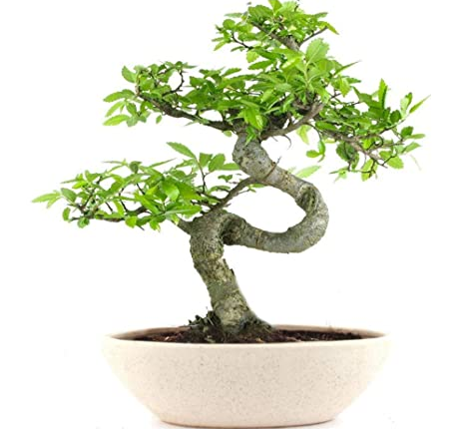
What is Bonsai?
Bonsai is a Japanese art form that involves growing and shaping miniature trees in containers to resemble a mature tree in nature. It is a practice that has been developed over centuries and involves techniques such as pruning, wiring, and potting to create aesthetically pleasing and balanced compositions. Bonsai trees are grown for their beauty and are often seen as a symbol of harmony, balance, and peace.

Slide 3

About us
PlantKingdom is a leading provider of a diverse range of high-quality plants, offering customers a unique and inspiring selection of species to bring life to their homes and offices. With our commitment to sustainability and customer satisfaction, PlantKingdom is the ideal destination for anyone looking to bring nature indoors. Recently we have just lunched our E- Commerce website of “PlantKingdom”.

Slide 4



Meet the team
Nayan Raj Sah
Arbin Rajbanshi
Mohammad Nurullah

Slide 5
Group Work Contributions
Mohammad Nurullah (Wireframe & Designing)
Nayan Raj Sah (Coding)
Arbin Rajbanshi (Documentations)

Slide 6

Introduction to Website
This is a website where bonsai plants are sold online.
This website was created with the use of HTML, CSS, and JavaScript.
This single page navigation website.

Slide 7
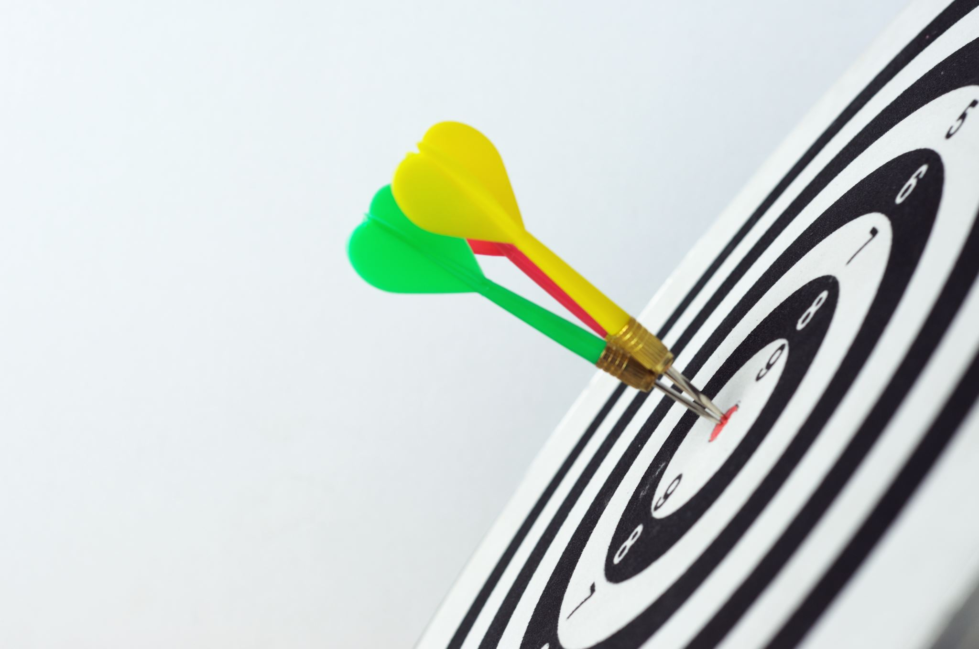
Goal & Objective
To become familiar with HTML, CSS, and JavaScript.
The capability to develop websites that are dynamic.
To create raw designs and structure of the webpages.

Slide 8
Home Page
This is the default
webpage of the
Website.
It will assist in directing viewers to more pages with only one click.
Directly Navigate to our offline store, sign in, and cart.

Slide 9
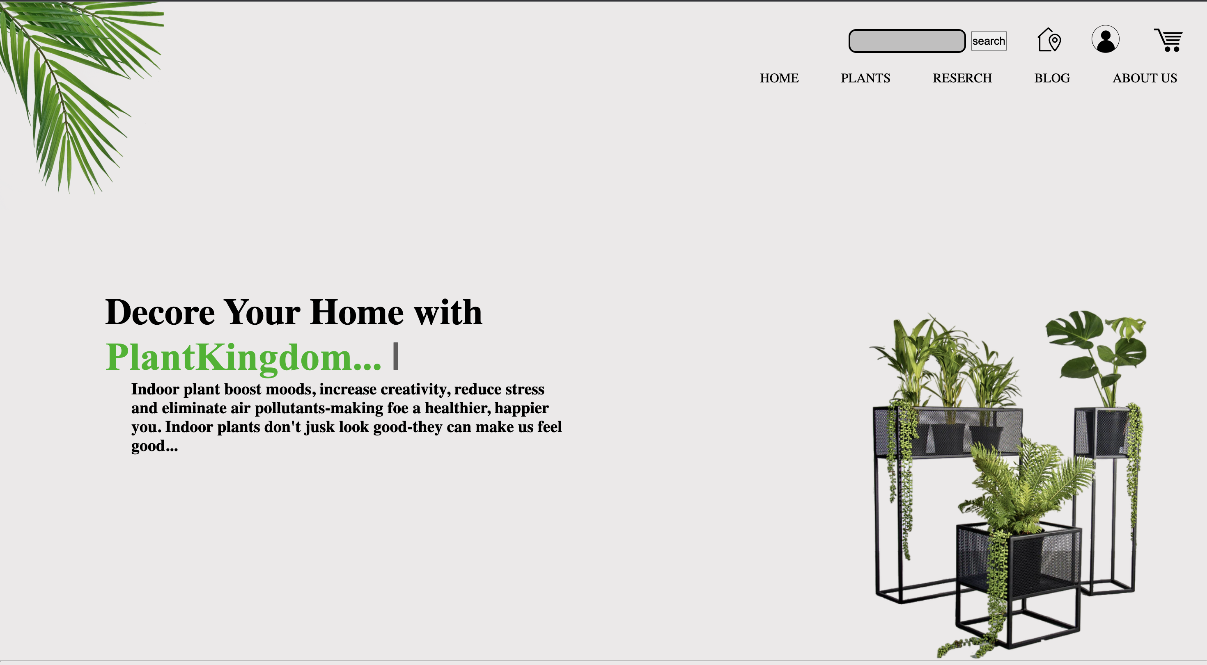

Slide 10
Plant Page
This page consists of, what’s verities of plant are available and which product are available in this website.
Customers can view price details about many types of plants and products here.
Customer are able to order their chosen products from this page webpage by using the “Add to Cart ” button.
Customer can also be able to visit and buy other verities of plant from this page.

Slide 11
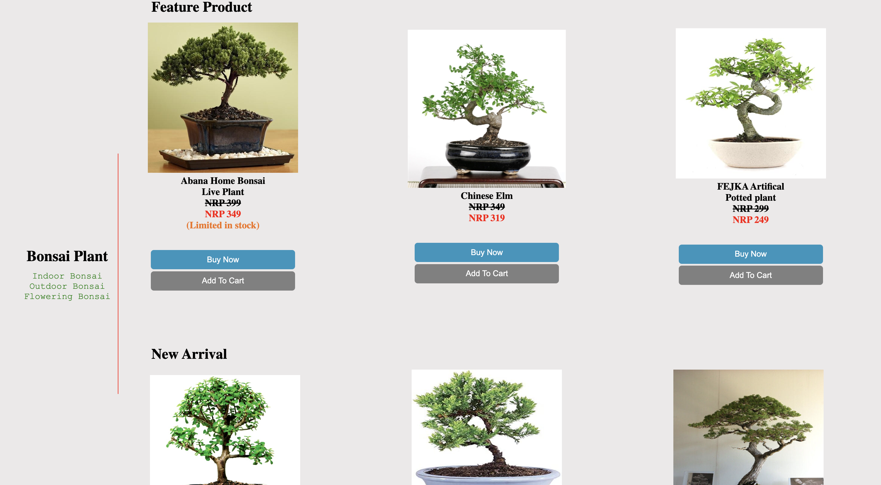

Slide 12

Research Page
This page includes a list of all the websites used as sources when creating this one, along with screenshots.
Each page on our website is compared side by side with a page that is similar on other websites.
Also mention why that particular elements are selected.

Slide 13
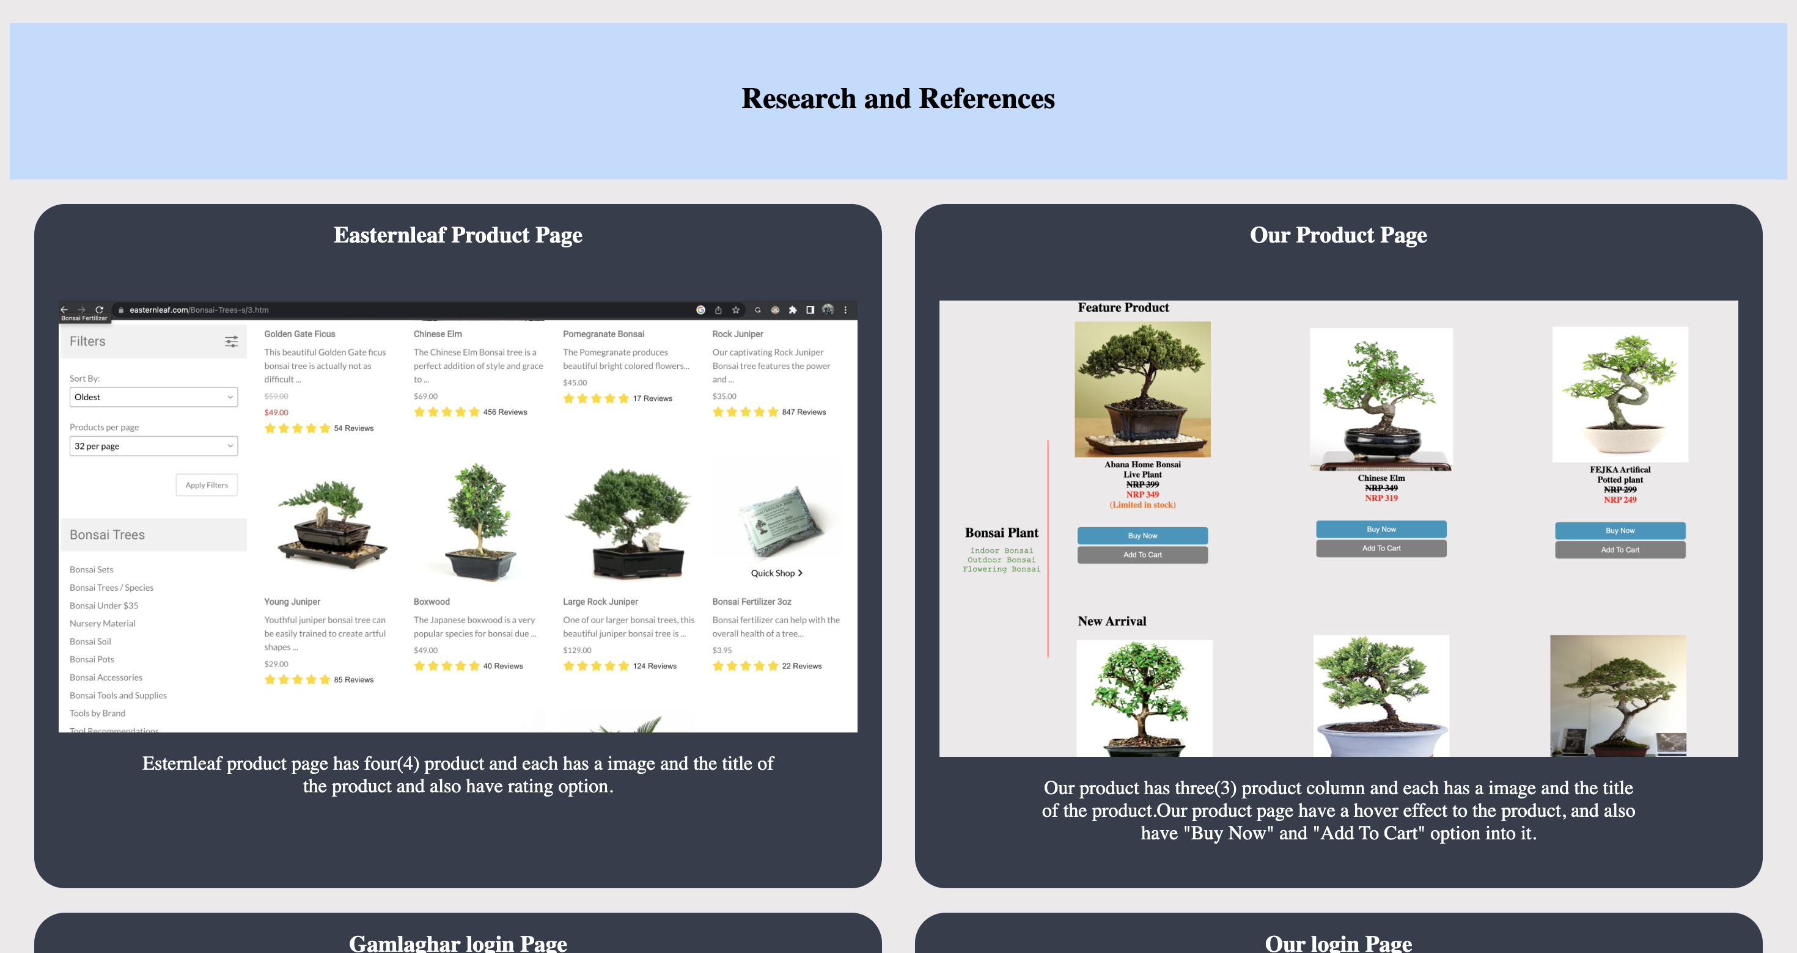

Slide 14

Blog Page
This webpage provides customers with valuable information about our journey to bonsai entrepreneur.
It covers subjects including the benefits, drawbacks, and impact of technology.

Slide 15
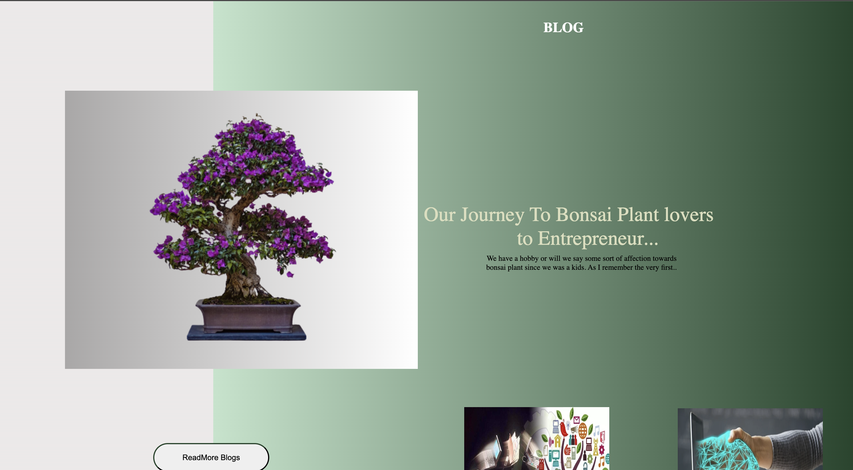

Slide 16

About Us Page
Each team member who contributed to the creation of this website has a portfolio and a resume on this page.
Contains the social media handles of each team member.
Also have Feedback for customer.

Slide 17
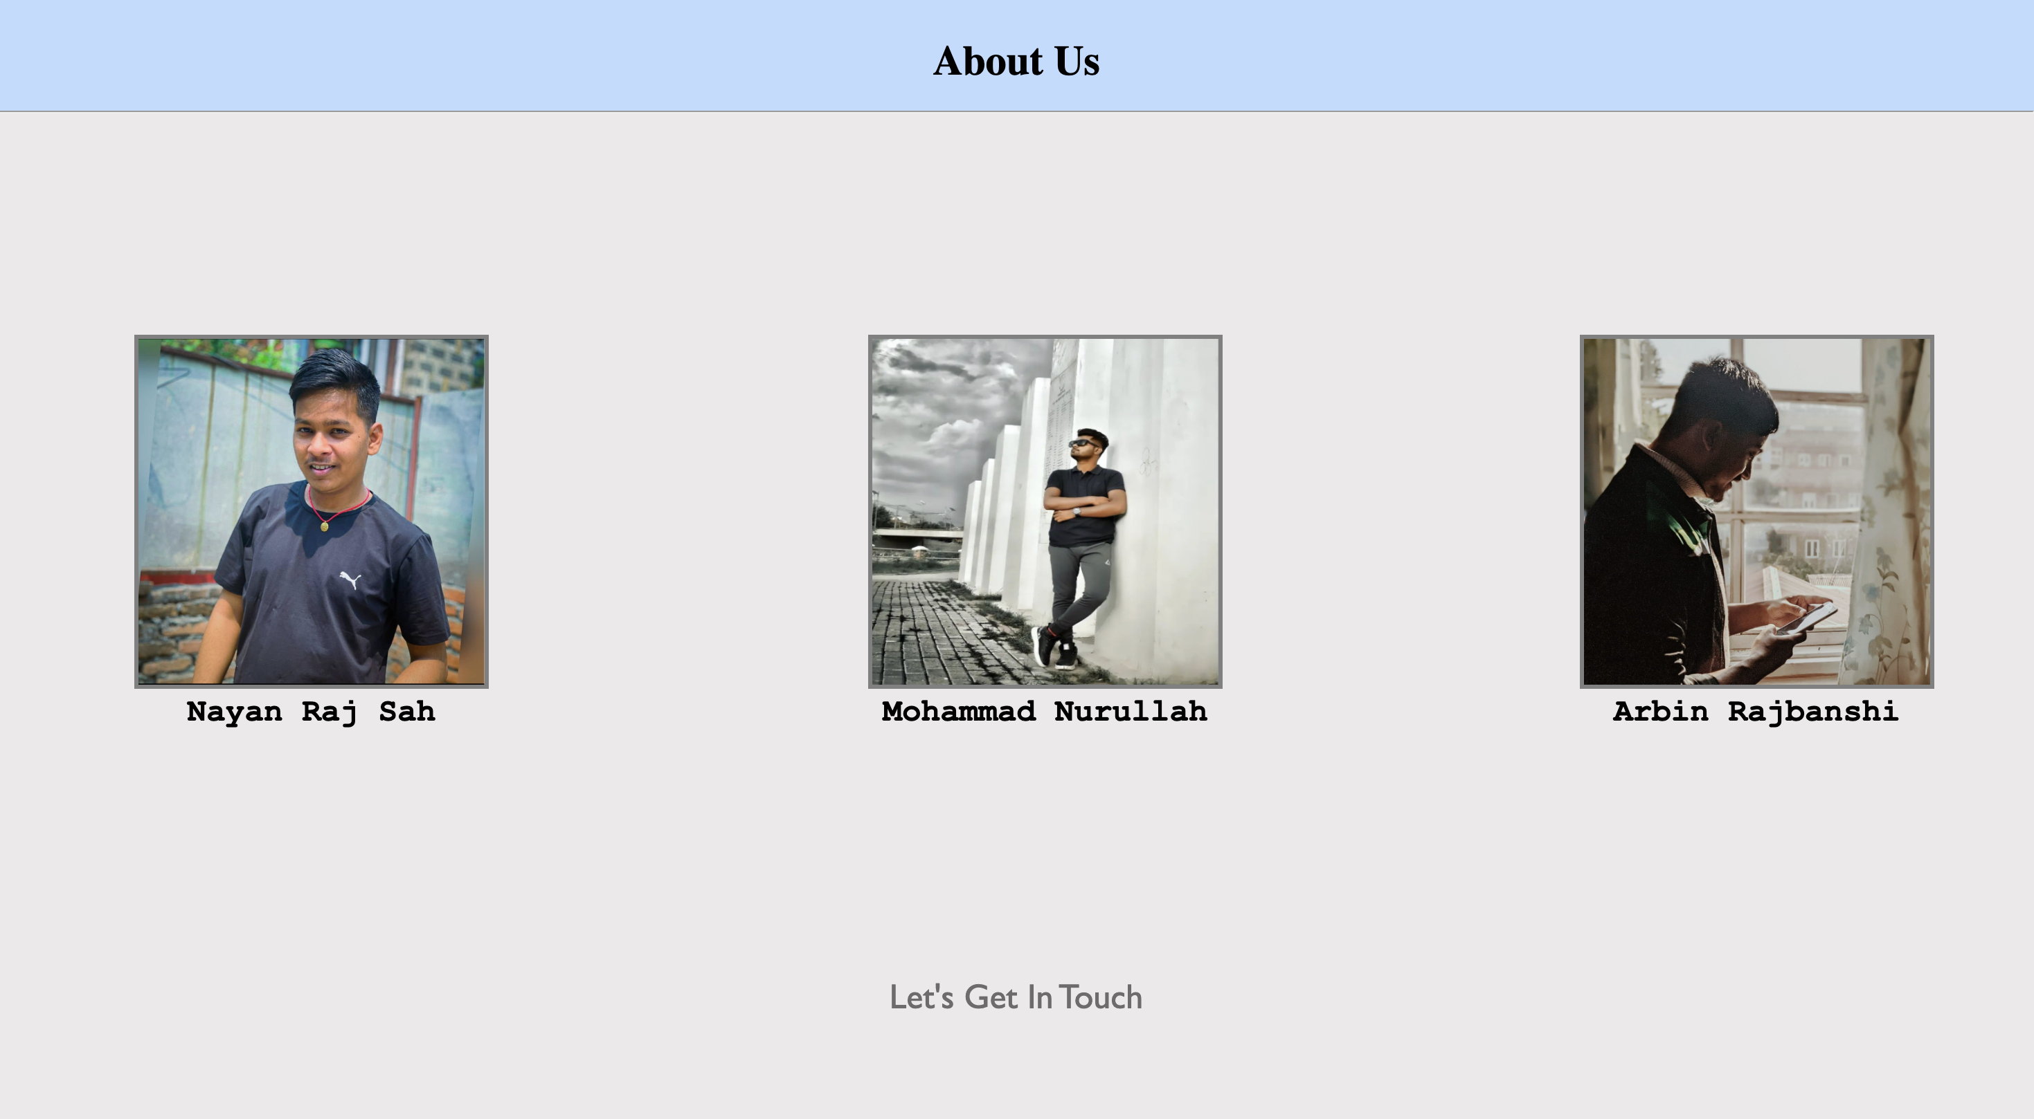

Slide 18
Basic Used Tags
Title : The <title> tag defines the title of the document displayed in the browser tab and used as a summary by search engines.
Meta : The <meta> tag in HTML provides metadata information about the document, such as description, keywords, author, character encoding, and more, to search engines and other systems
Header : The <header> tag in HTML defines a header section for a document, which usually contains introductory content such as the logo, navigation, and main heading.
IMG : The <img> tag in HTML displays an image on a web page, specified by the source file URL in the "src”.

Slide 19
Basic Used Tags
Table : The <table> tag in HTML defines a table for tabular data, with rows defined using <tr> tags and cells defined using <td> or <th> tags for data or header cells, respectively.
Division : The <div> tag in HTML defines a division or a section of a web page, serving as a container for other HTML elements and providing a way to apply styles to multiple elements as a group.
Span : The <span> tag in HTML defines a small inline portion of a text, used to apply styles to a specific part of a text or to group together small chunks of HTML content for styling purposes.

Slide 20
JavaScript- Type Writer
This JavaScript code implements a "typewriter" effect for a text animation on a website. The text to be animated is stored in an array text and the animation is performed by the typeWriter function. The typeWriter function increments the position of the character in the array (j) and the position of the text in the array (i) until all the texts in the array have been displayed. Then, the animation starts again from the beginning. The code also implements a blinking cursor, which is made visible and hidden with a set interval of 400ms.

Slide 21
JavaScript- Add to Cart
The JavaScript that implements an "Add to Cart" button functionality for this website. When the "Add to Cart" button is clicked, the count of items in the cart is incremented and displayed in the element with the id "cartCount". The initial value of the count is set to 0. The function updateCartCount is used to update the cart count display and ensure that it is visible when the count is greater than zero. The event listener attached to the "Add to Cart" button calls the updateCartCount function every time the button is clicked.

Slide 22
Thank you

